Slide 1
Strong-Style Pairing
Llewellyn Falco & Maaret Pyhäjärvi
Setup
Paper
Please write the languages you speak
Laptop (if you have one, not required)
Please setup an IDE of your choice
English Finnish Swedish
Paper
Please write the language of the environment
JAVA

Slide 2
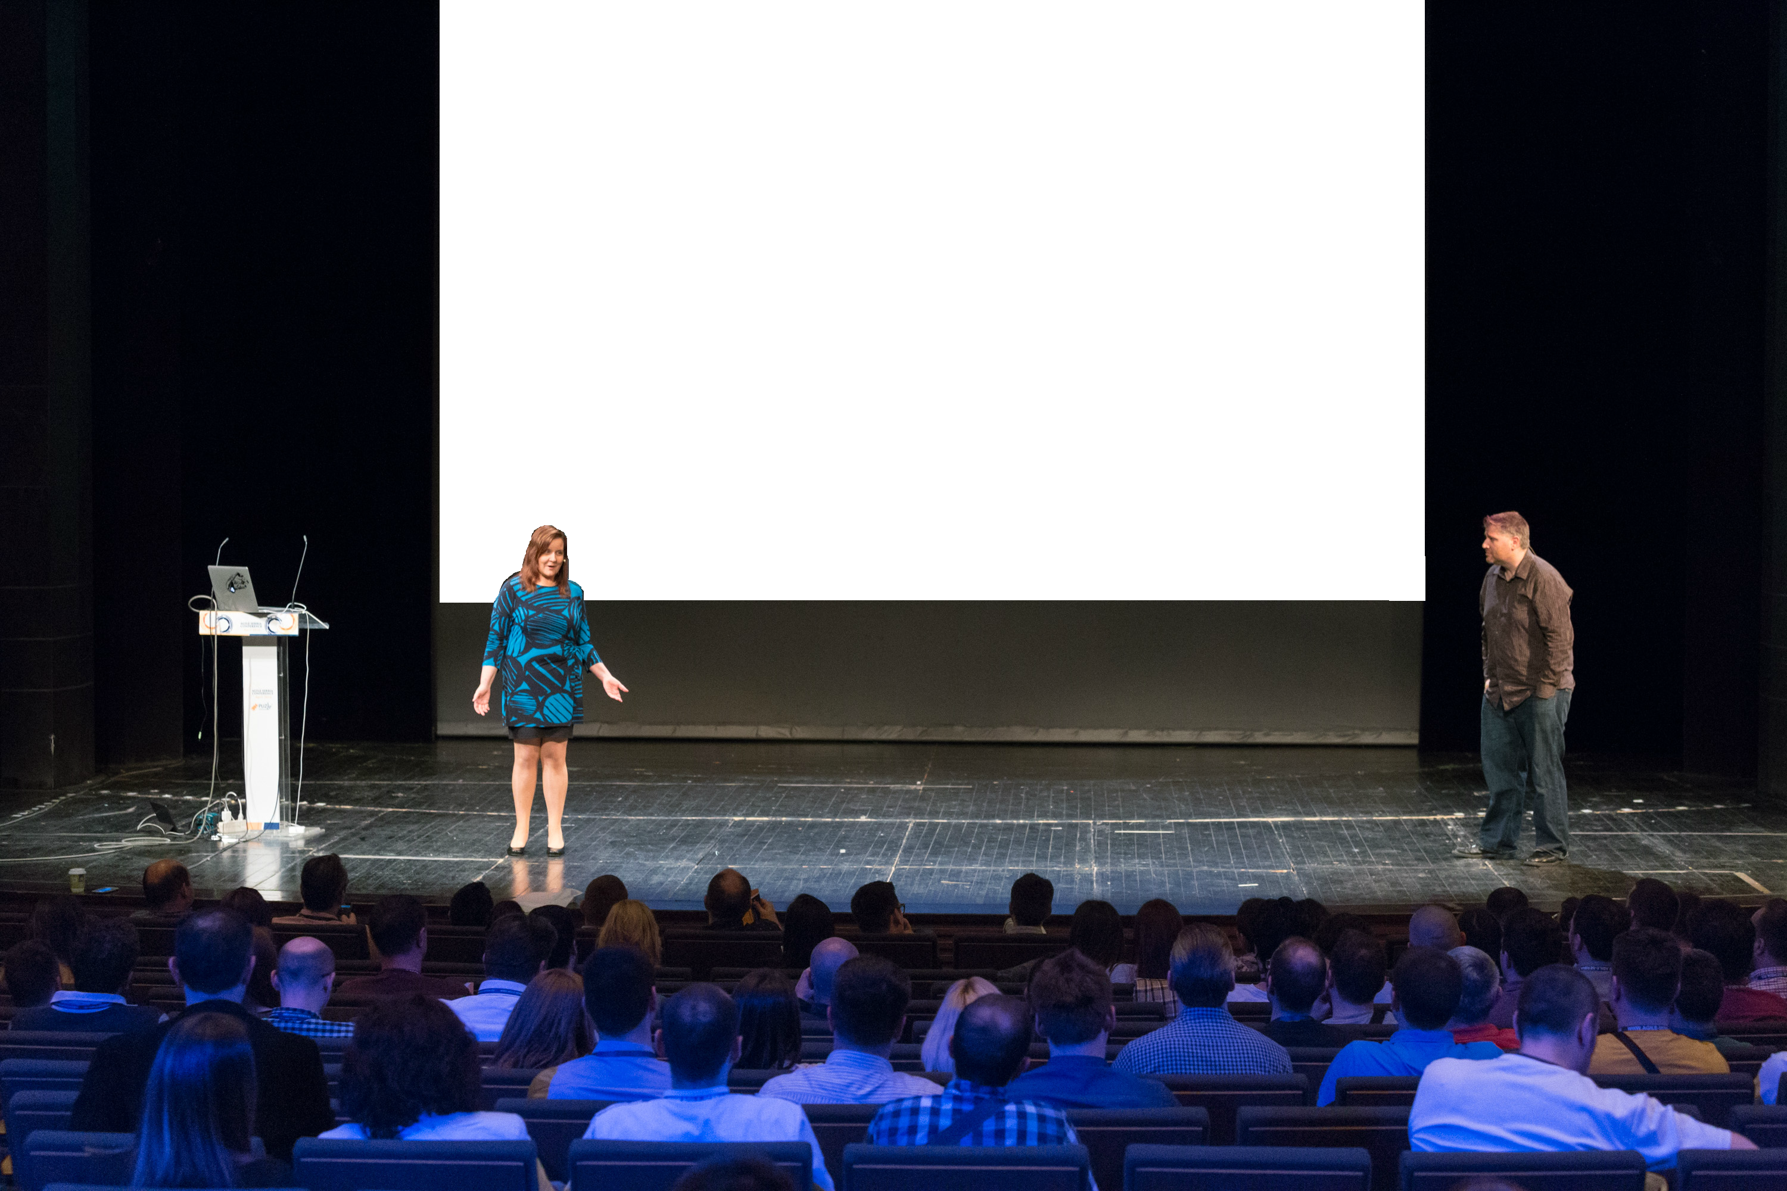
Strong-Style Pairing
Llewellyn Falco
& Maaret Pyhäjärvi

Slide 3
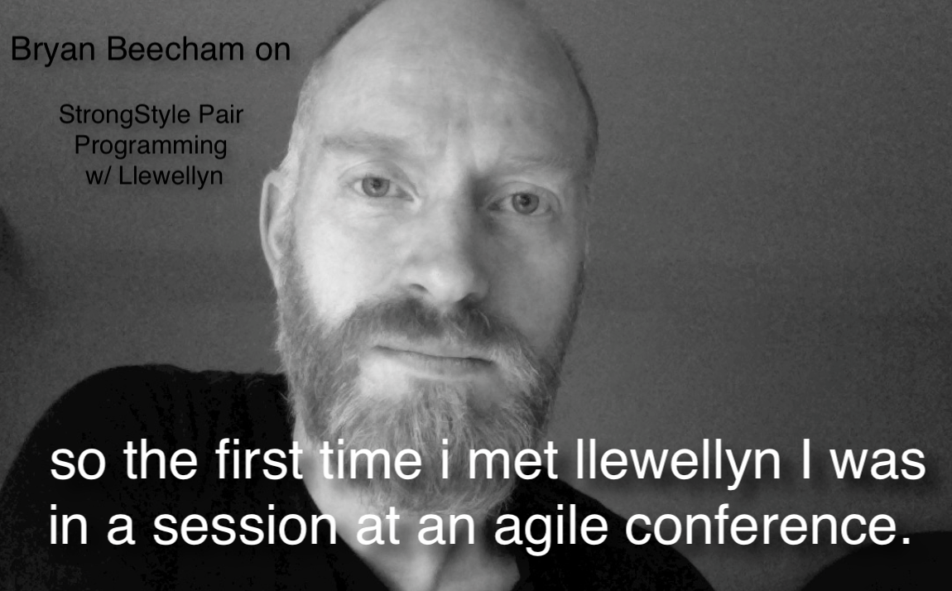


Slide 4
“For an idea to go from your head to the computer it must go through someone else’s hands”

Slide 5
Comparison
Traditional
Strong Style
I have an idea…
Give me the keyboard
I have an idea…
Please take the keyboard

Slide 6
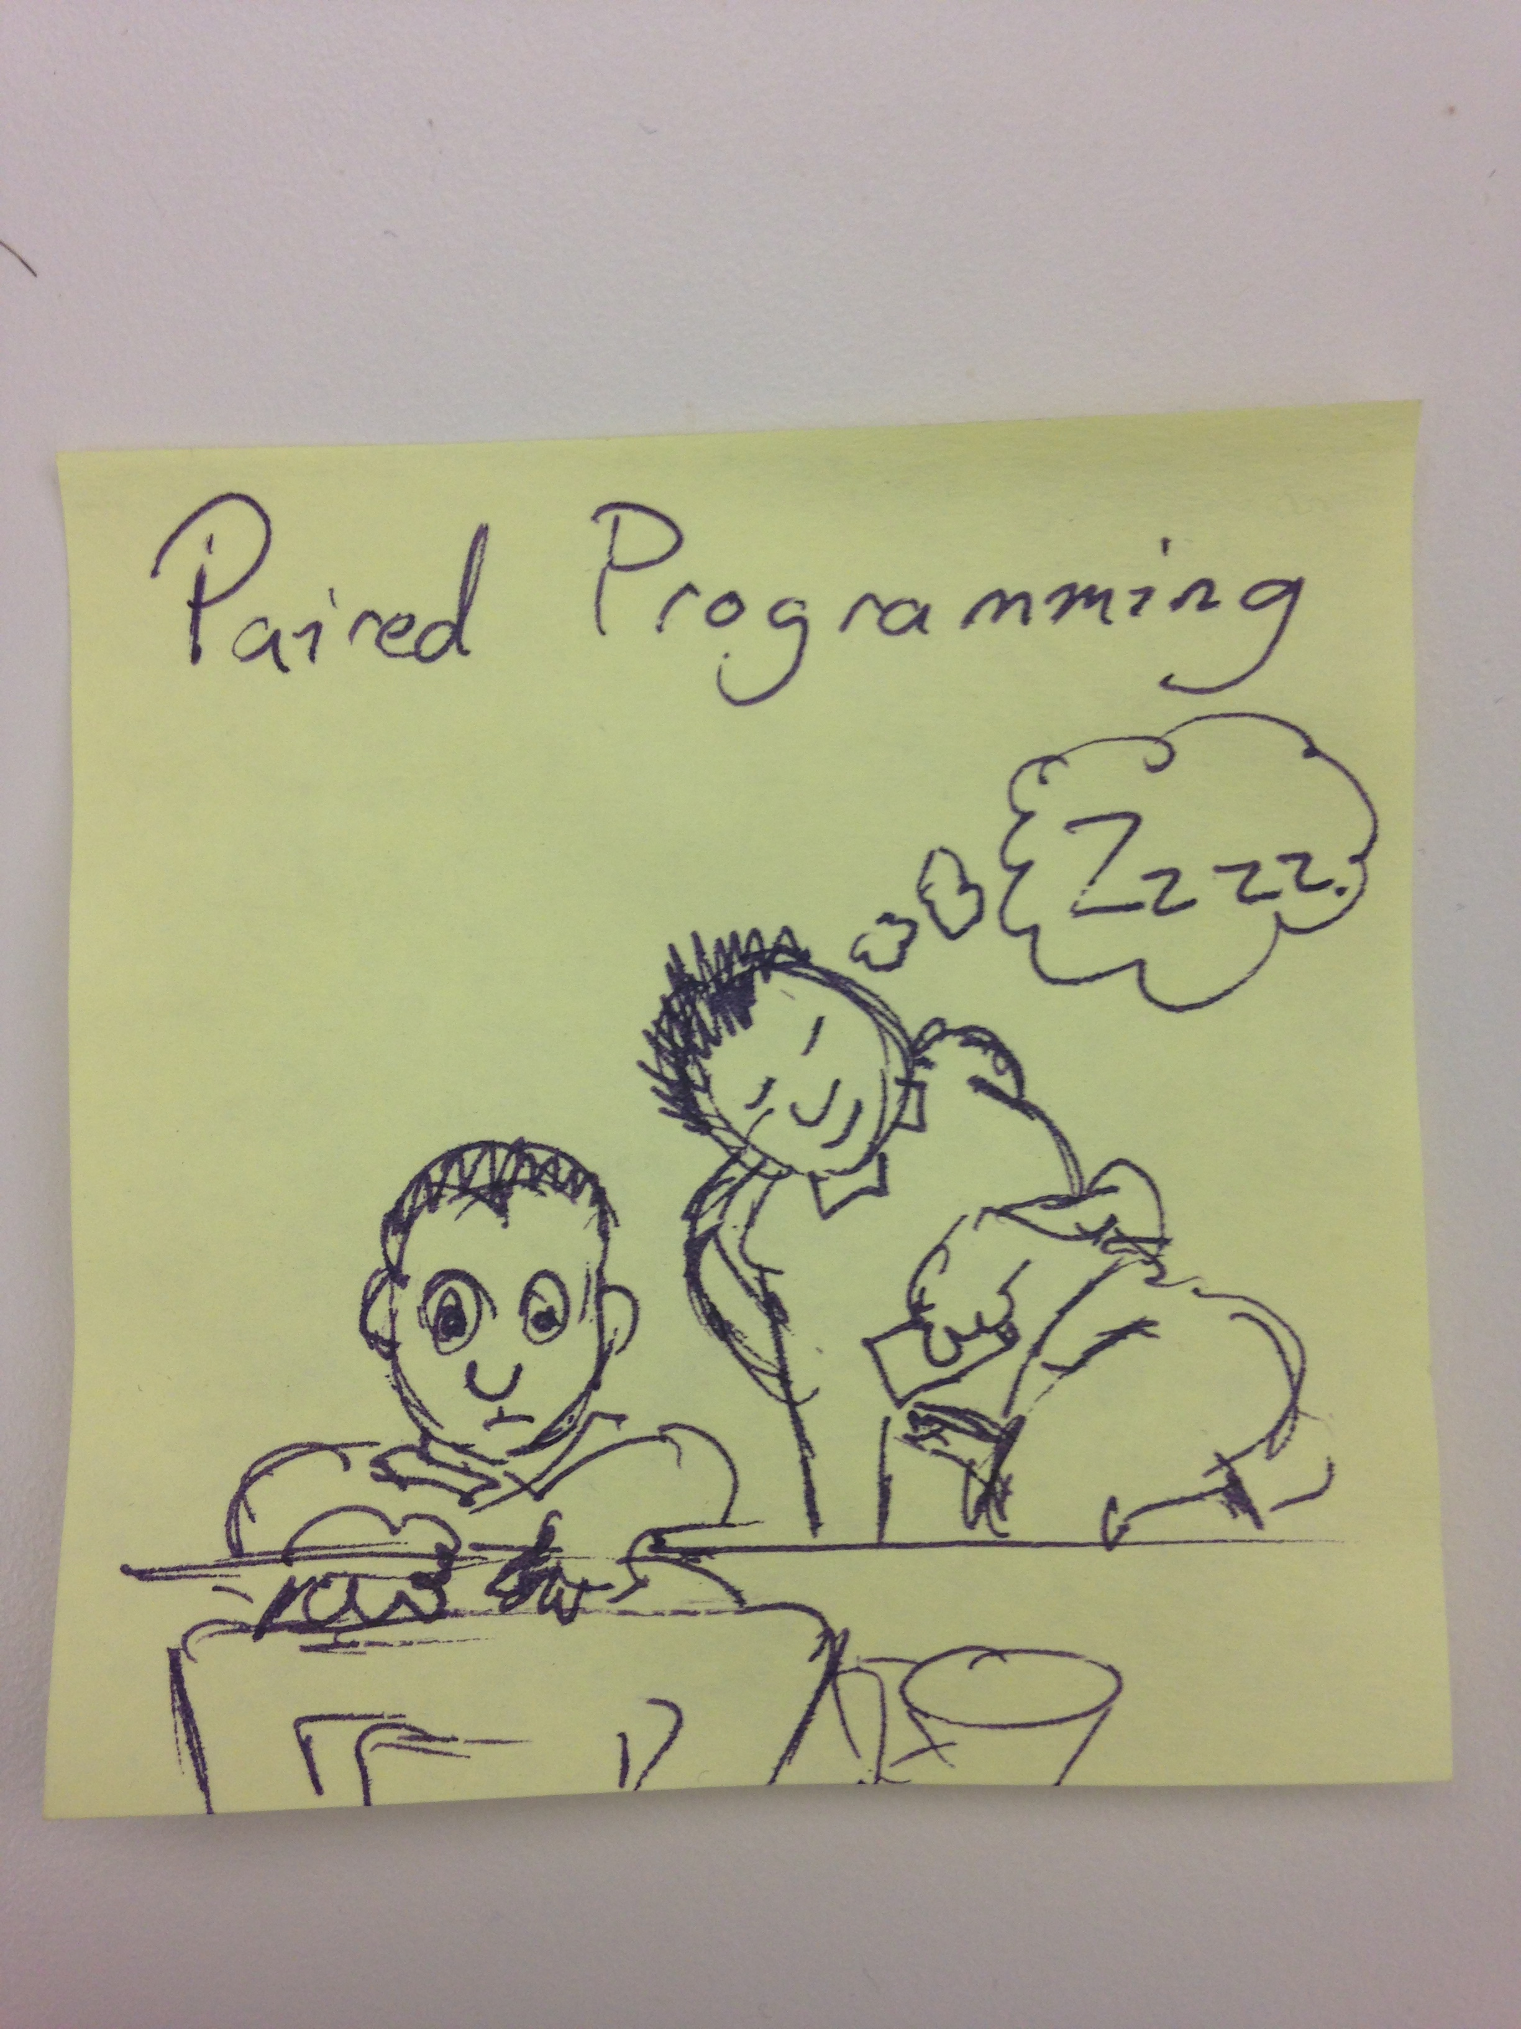

Slide 7
Strong-Style Experience (Phone Exercise)

Slide 8
Highest level of abstraction Intent Location Details

Slide 9
= vs. ==
assign vs. compare

Slide 10
Strong-Style Experience (Phone Exercise reversed)

Slide 11
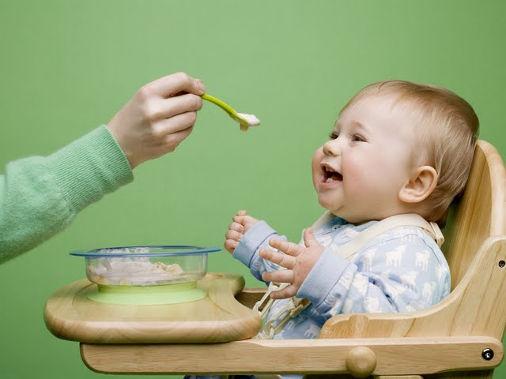
Feeding the driver
Notes:
Not while chewing
Avoid chocking
You are responsible for taking care of the driver

Slide 12
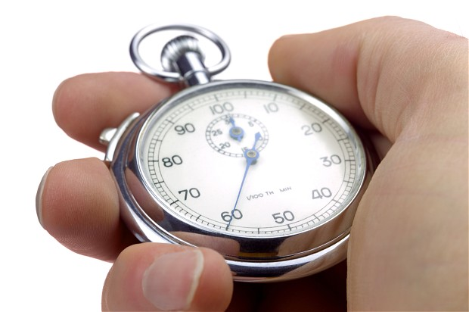
Establishing Trust

Slide 13
Navigation Exercise
If you are working on a task or doing test-first development, it is very useful to have an example written on a whiteboard. The examples should be very simple, and only show one path at a time. This means you can not use conditional words like "or", "if", "depending", or "maybe".

Slide 14
Navigation Exercise
If you are working on a task or doing test-first development, it is very useful to have an example written on a whiteboard. The examples should be very simple, and only show one path at a time. This means you can not use conditional words like "or", "if", "depending", or "maybe". If there is an example, it might take many turns before its finished, and having it on the board will give guidance for the whole team on what they need to do as each new navigator takes over and continues on the task. Examples should make you feel like the person telling the example actually did the thing yesterday.

Slide 15

Rapid Learning
Approval Tests

Slide 16
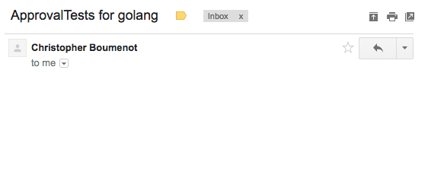
Christopher Boumenot
to me
I would like to contribute Approval tests for golang to the official GitHub repository.
Is this something that you would be interested in?

Slide 17
Llewellyn Falco
to Christopher
YES AND HELL YES!
Would you be able to pair something next week?

Slide 18
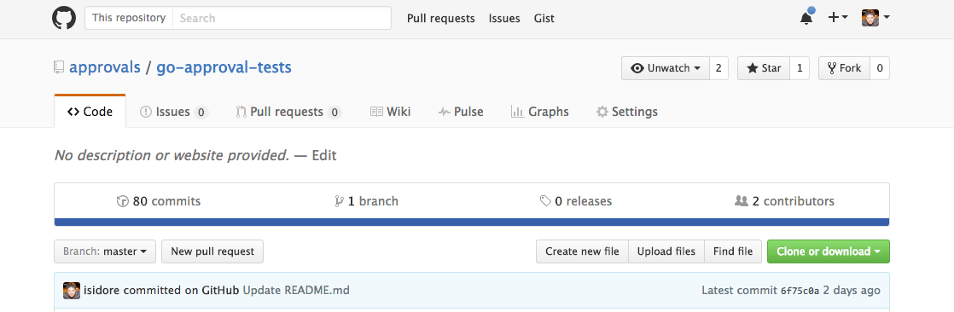
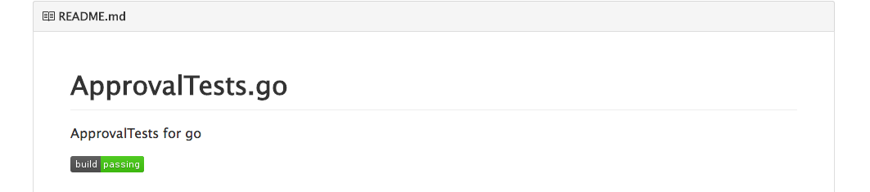

Slide 19
Learning as a driver (Language demo) traditional strong-style

Slide 20
Learning as a driver (Language Exercise) traditional strong-style

Slide 21
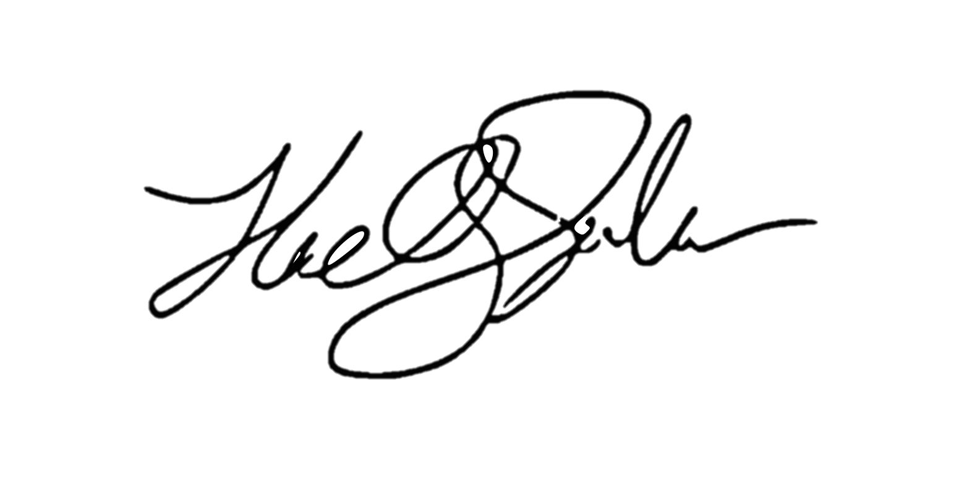
ROI of spending 1 hour a day
learning for a 1% increase
5x (1 year)
4x (10 months)
Output
2x (6 months)
3x (8.5 months)
28 days
Llewellyn Falco

Slide 22
Rules of Pairing Try it Yes, and… Do first, explain later Look for wins

Slide 23
Coding exercise (Fizz Buzz) 1, 2, Fizz, 4, Buzz, Fizz, 7, 8, Fizz, Buzz, 11, Fizz, 13, 14, FizzBuzz, 16, 17, Fizz, 19, Buzz

Slide 24
When you pair on
Hard problem ➔ Solution
Easy problem ➔ Innovation

Slide 25
Switching on time on task on idea

Slide 26
Traditional Pair Programming Problems
Can’t keep up
Slows me down
Disengaged
Ownership / Self worth
Scary
Hogging the keyboard

Slide 27
Homework Assignment Initiate & pair with 1 new person at this conference

Slide 28
References Podcast: http://hellotechpros.com/llewellyn-falco-productivity/ Llewellyn’s Blog - Definition: http://llewellynfalco.blogspot.com/2014/06/llewellyns-strong-style-pairing.html Maaret’s Blog - Experiences: http://visible-quality.blogspot.fi/search/label/Pairing

Slide 29
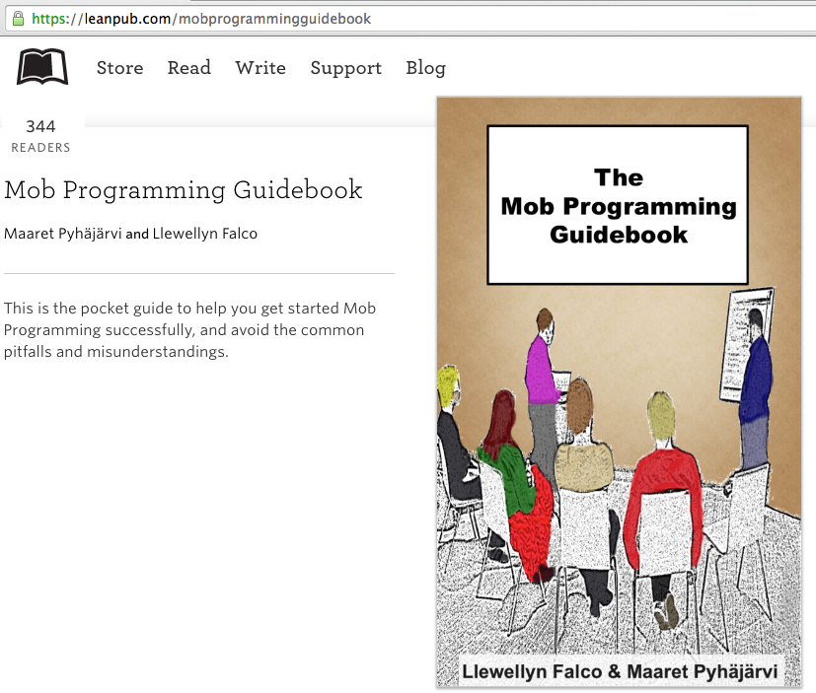
#MobProgrammingGuidebook

Slide 30
Thank you.
Slides:
http://www.slideshare.net/llewellynfalco/strong-style-pairing
@maaretp
@LlewellynFalco
(please connect with us through Twitter or LinkedIn)

